Slide 1
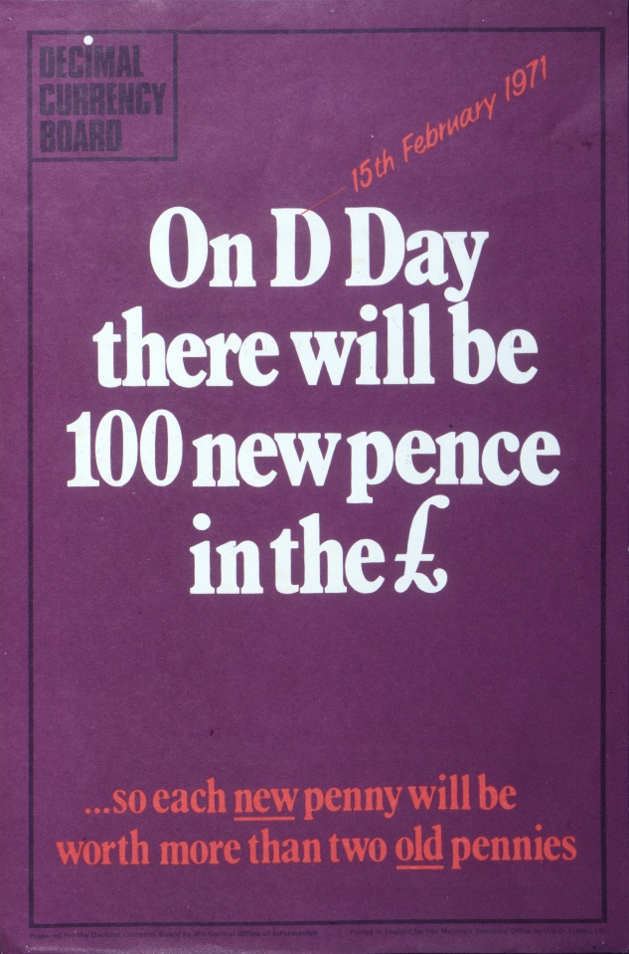
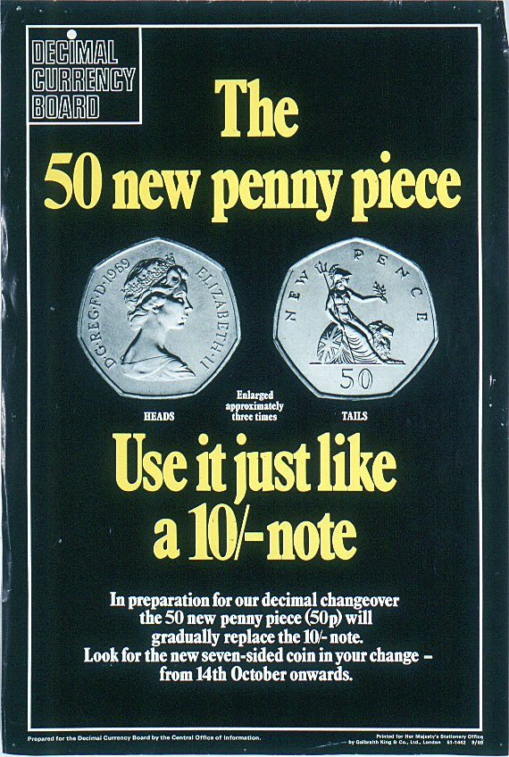
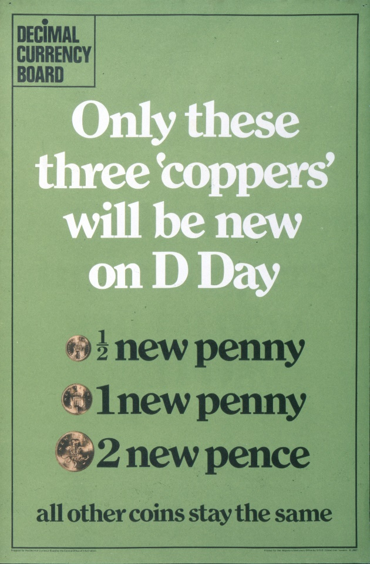
The Story of Decimalisation

Slide 2
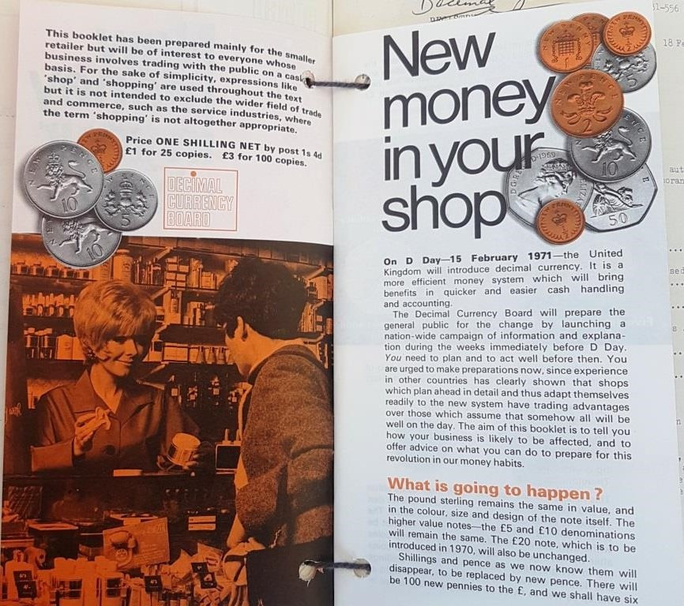
A new way of counting
We are all so familiar with the change in our pockets that we rarely give it a second thought.
The coins we use every day are such ordinary objects, do you ever think about how they are made or why they look the way they do?
You may not realise it but the money that we use today is part of a decimal system, with 100 pennies in a pound. This is actually quite new and has only been around for fifty years.

Slide 3
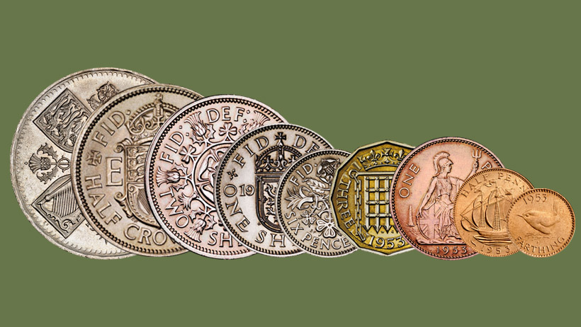
Before this, in the United Kingdom, there was a system that had been around for centuries which was very different and much more complicated. We still had pounds and pence but we also had coins called shillings, and the maths of our money was very different. Instead of there being 100 pennies in the pound there were 240. This is because the pre-decimal money was based on multiples of twelve, whereas the decimal money we use today, is based on multiples of ten.

Slide 4
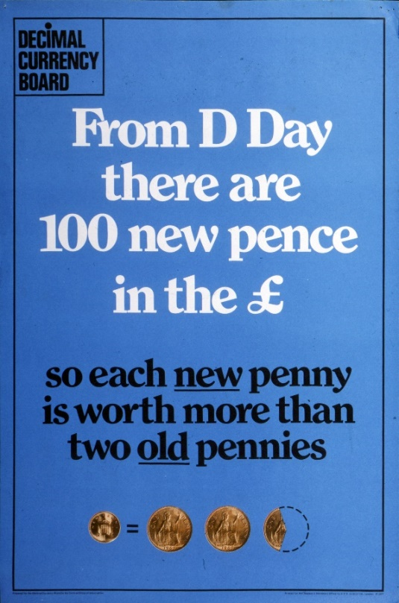
The changeover
It was announced in 1966 that the United Kingdom would be switching their currency from the old system to the new decimal money. The date for the changeover was set as 15th February 1971, a day that was to be known as Decimal Day or D-Day for short. By this time, we were one of the few countries that didn’t use decimal currency so there was a need for us to modernise and catch up with the rest of the world.
It was a huge task to prepare the country for the changeover. Everyone would have to learn how to use the new currency. New coins and notes would have to be designed, shop tills and vending machines would have to be changed so they could take the new money, even school text books would have to updated to help teach children to use the new money.

Slide 5
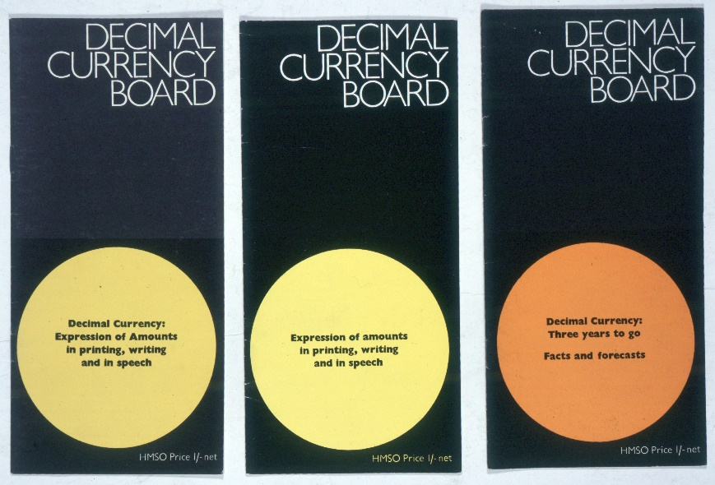
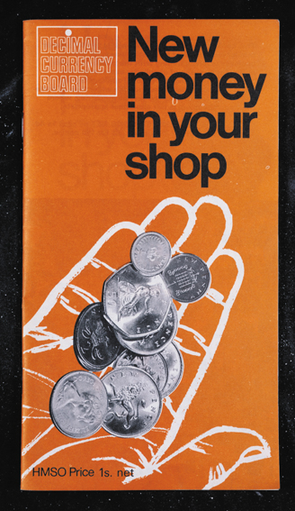
A group called the Decimal Currency Board was set up by the government to oversee the change and make sure that it all ran smoothly.
A big public information campaign was launched to help people get ready for Decimal Day. Information films were shown on television, booklets and posters about decimalisation were printed and displayed in shops and banks, and there were even songs written about going decimal.

Slide 6
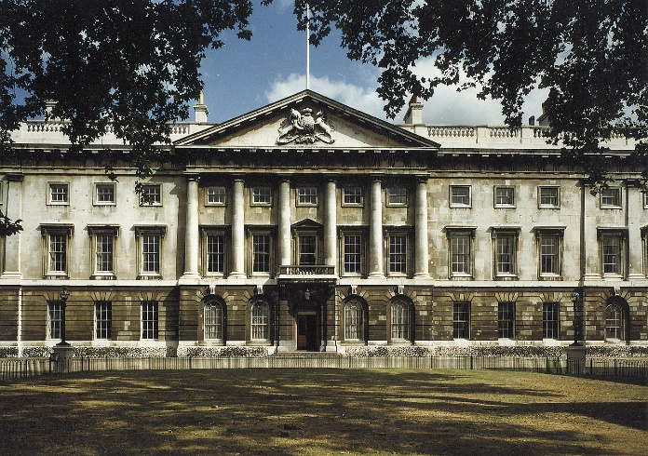
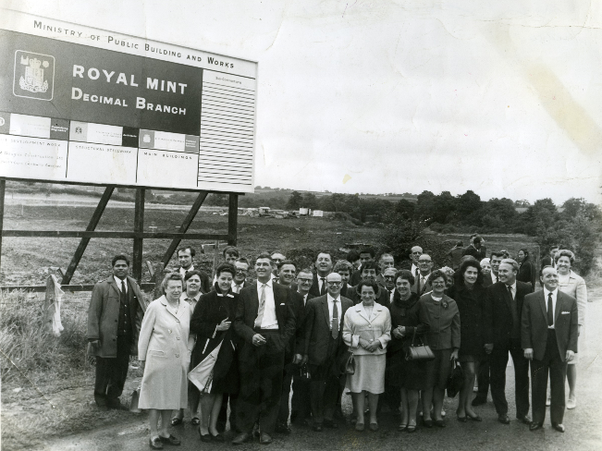
Making the new coins
During this time the Royal Mint was based in London at Tower Hill. It was an old factory that had been built over 150 years before and wasn’t really set up to produce all of the millions of new decimal coins that were needed for the changeover. It was decided that a new, larger, modern mint would need to be built and a site at Llantrisant in South Wales was chosen for the new decimal branch. Building work began in 1967 and a year later, the site was opened by the Queen and began production on all the new coins. At the same time, all the old coins were starting to be collected so that they could be melted down and some of the metal reused for the new ones.

Slide 7
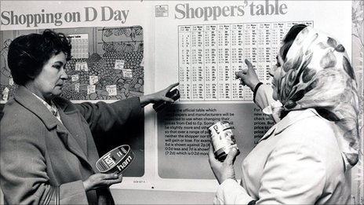
There was a lot of concern that D-Day itself would be chaos because people wouldn’t be prepared for the changeover, but the Decimal Currency Board did such a good job of getting the whole country ready that the day went by very smoothly and with very little fuss.

Slide 8
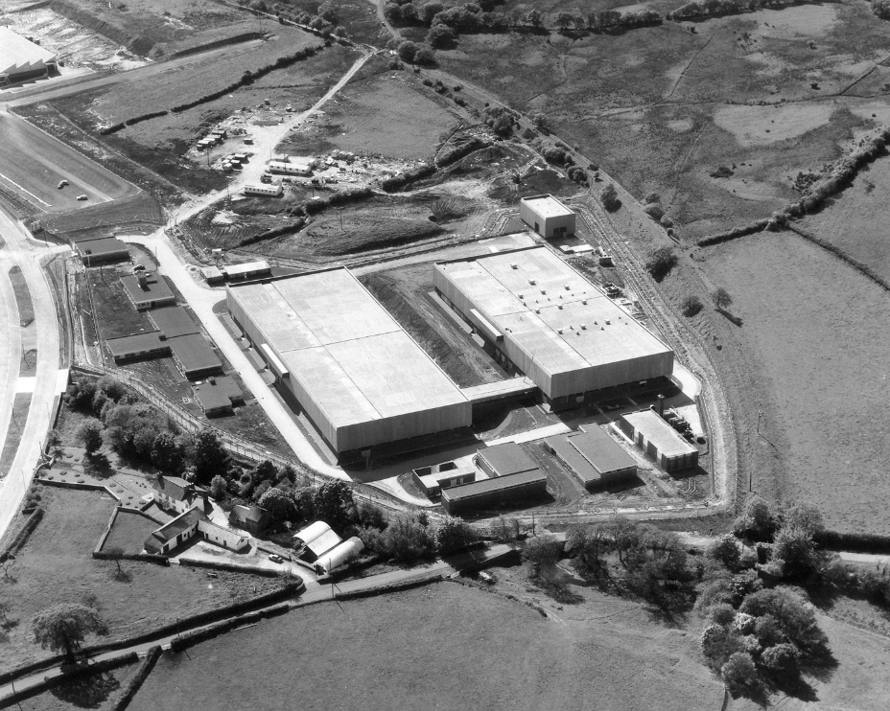
Eventually production wound down at the mint in London and moved permanently to the new site in Wales.
Ask if there’s anyone in your family or at your school who can remember the old money.
What do you think it would be like if you had to start using a new type of money?
Has this made you think differently about the coins we use?

Slide 9
Copyright of the Royal Mint Museum 2020
www.royalmintmuseum.org.uk
@TheRoyalMintMuseum
@RoyalMintMuseum
royal_mint_museum

